Slide 1
Freelance Session 2
Services -session
Type of services on the software development market
Freelance Sessions

Slide 2
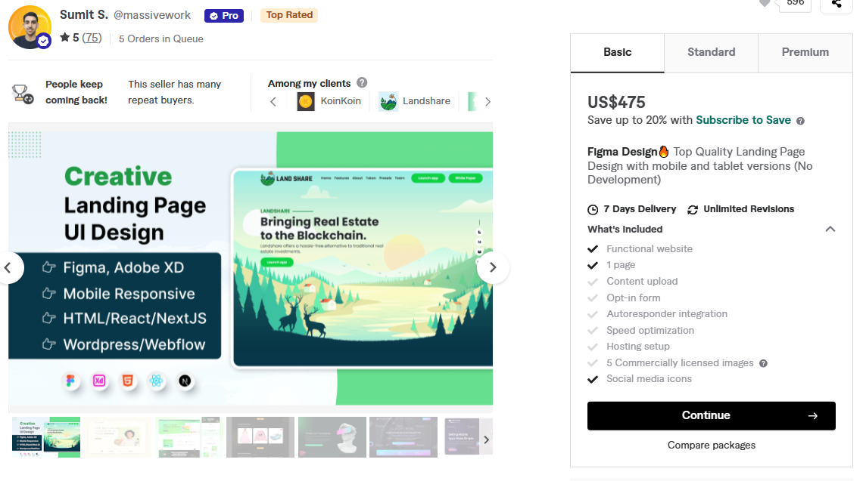
Services – Landing page
Landing page
UI
Freelance Sessions

Slide 3
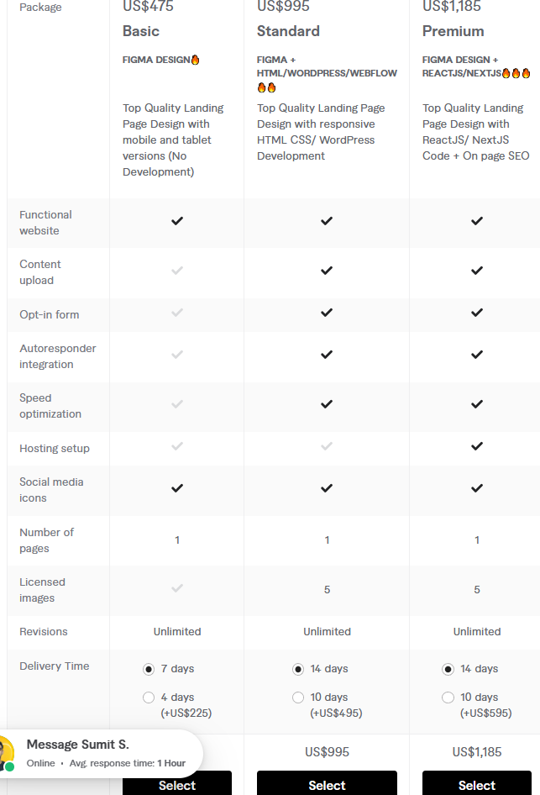
Services – Landing page
Landing page
UI
Freelance Sessions

Slide 4
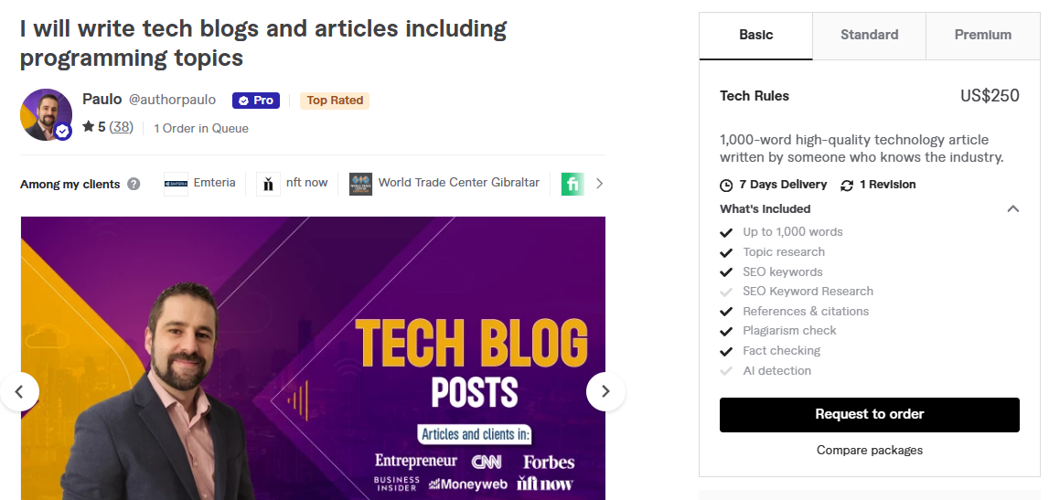
Services - Writing
Tutorials
Blogs
Freelance Sessions

Slide 5
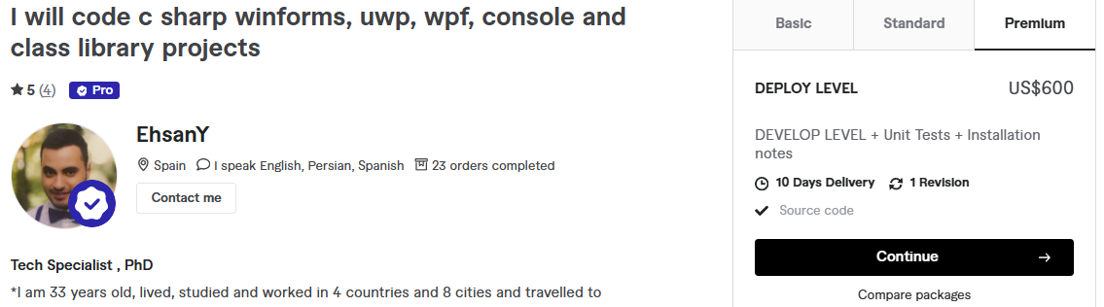
Services – Desktop apps
Windows form apps
Freelance Sessions

Slide 6
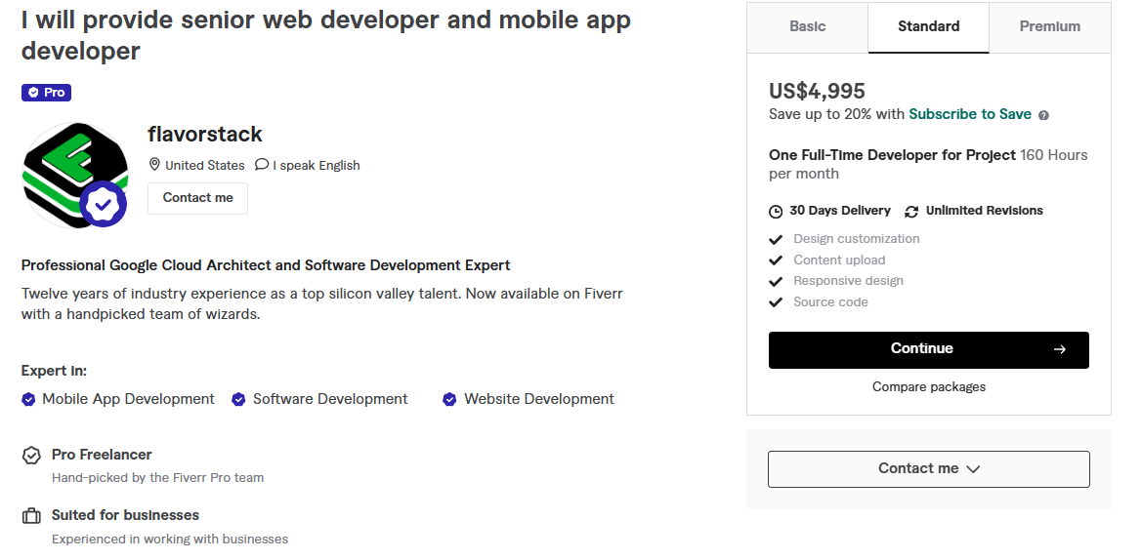
Services – End to End Web App
Freelance Sessions

Slide 7
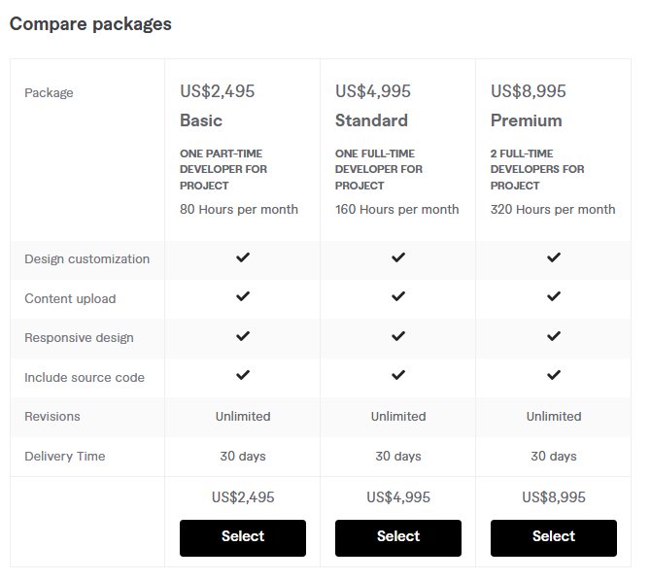
Services – End to End Web App
Freelance Sessions

Slide 8
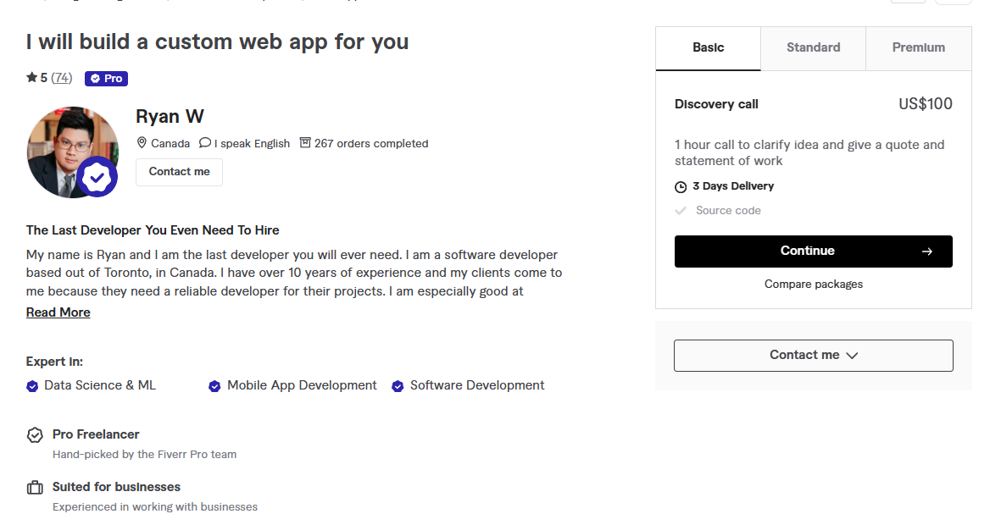
Services – Quotation + estimated duration for unique web-app projects
Freelance Sessions

Slide 9
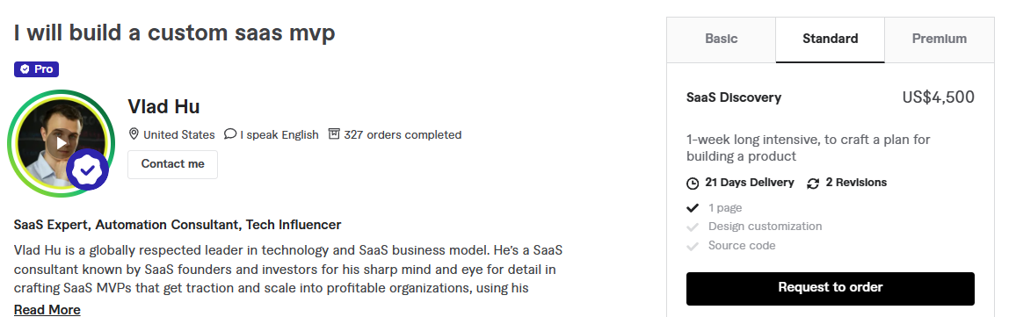
Services – Planning Unique App development with tasks and components required
Freelance Sessions

Slide 10
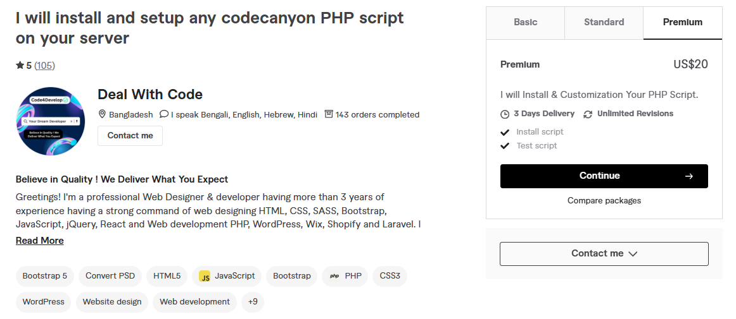
Services – Deployment and Config
Freelance Sessions

Slide 11
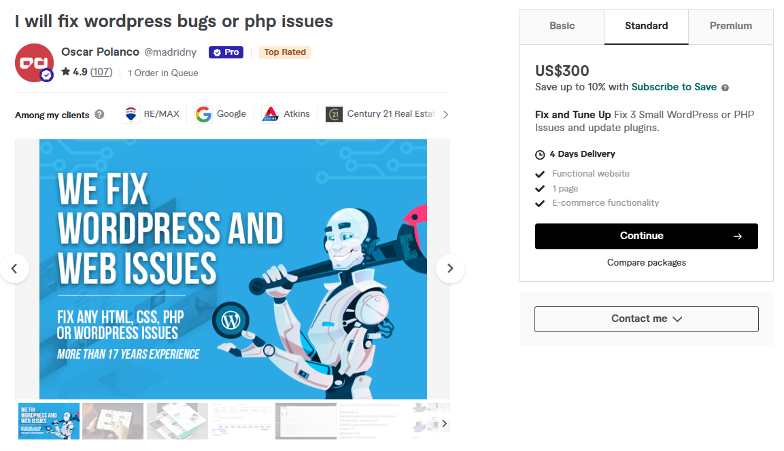
Services – bug fixes
Freelance Sessions

Slide 12
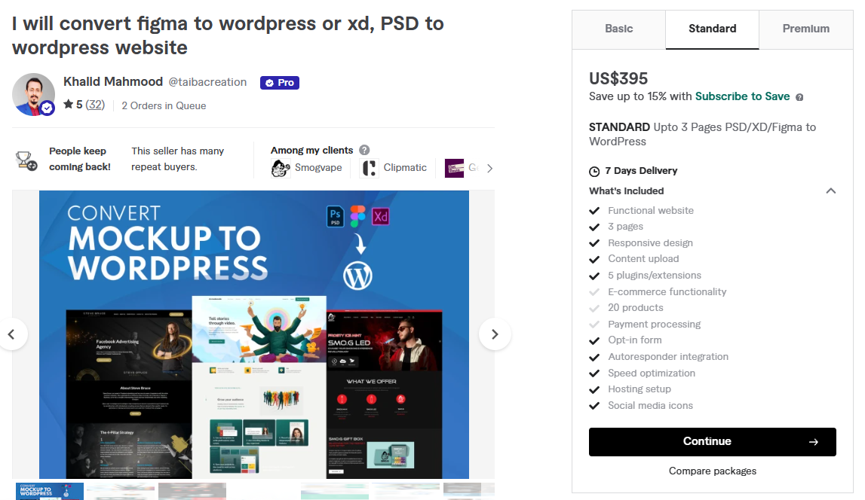
Services – UI to webpage
Freelance Sessions

Slide 13
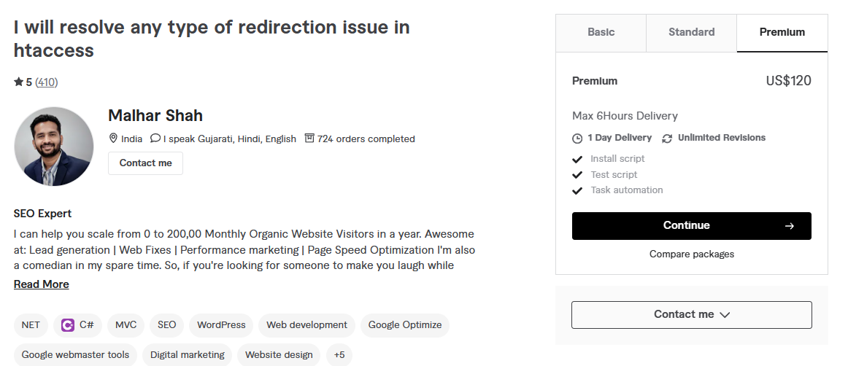
Services – DNS/HTTPS setup
Freelance Sessions

Slide 14
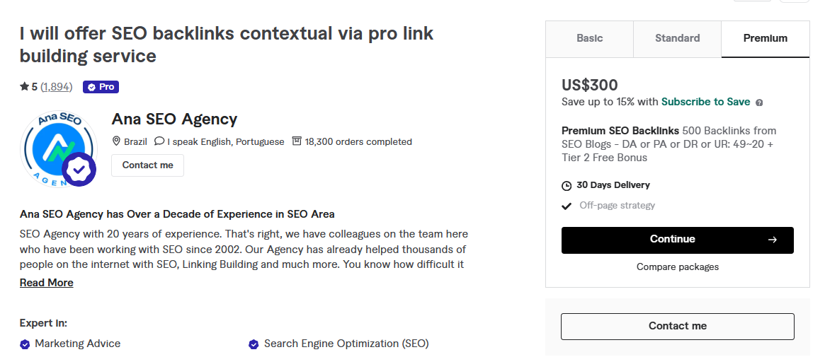
Services – SEO
Freelance Sessions

Slide 15
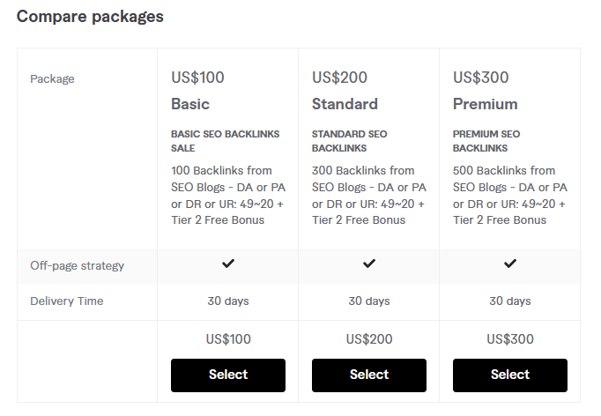
Services – SEO
Freelance Sessions

Slide 16
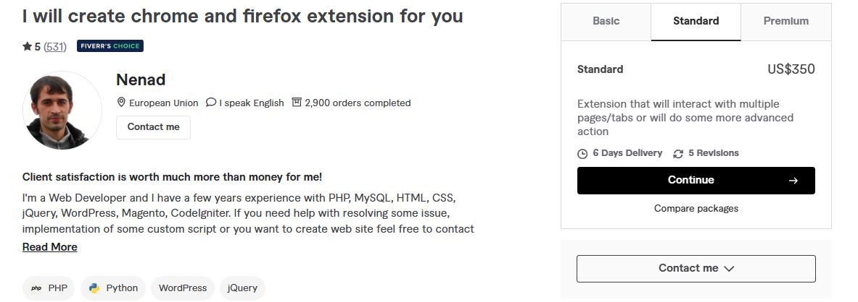
Services – Chrome extensions
Freelance Sessions

Slide 17
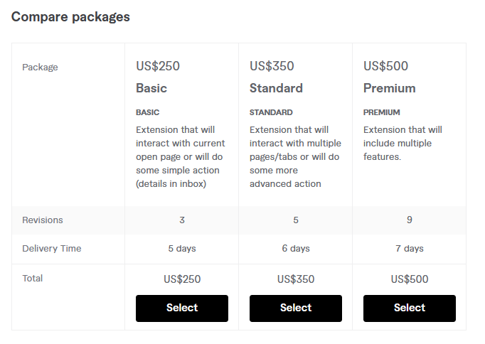
Services – Chrome extensions
Freelance Sessions

Slide 18
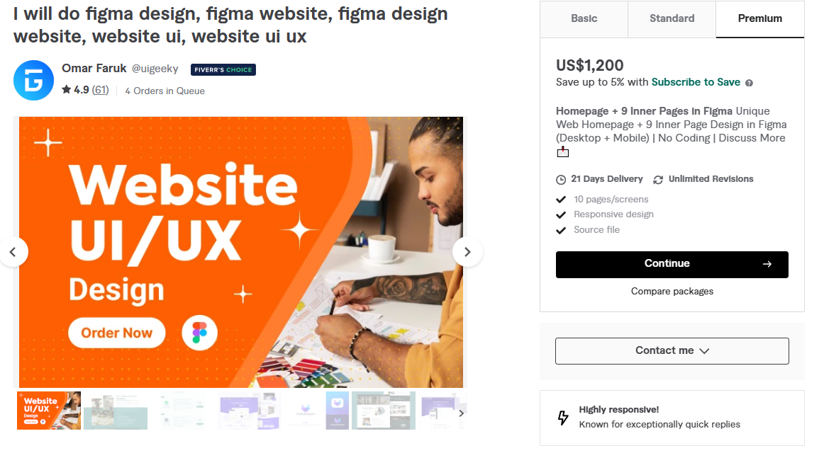
Services – UI Design
Freelance Sessions

Slide 19
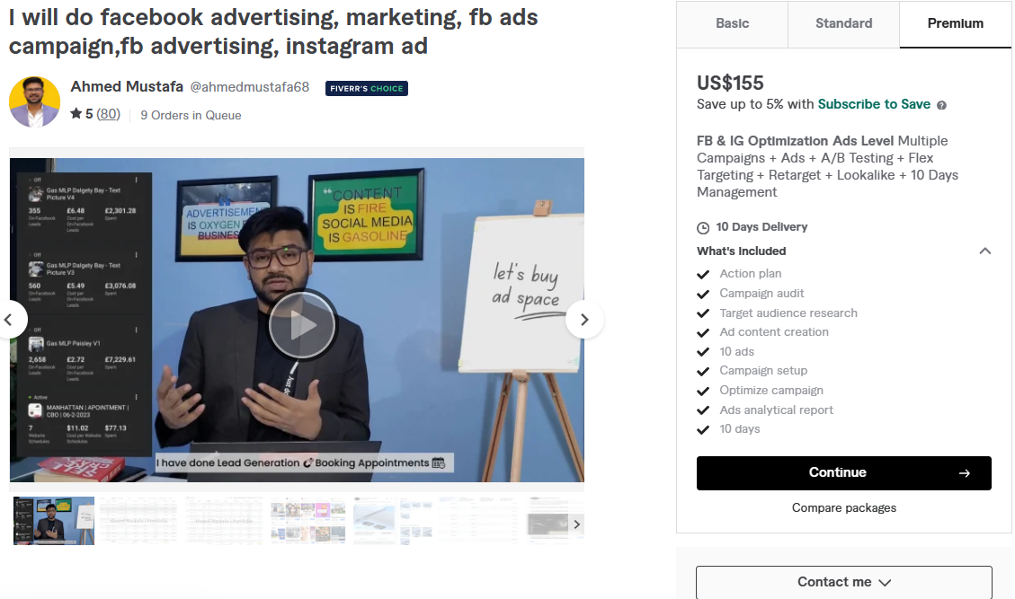
Services – Facebook Ads
Freelance Sessions

Slide 20
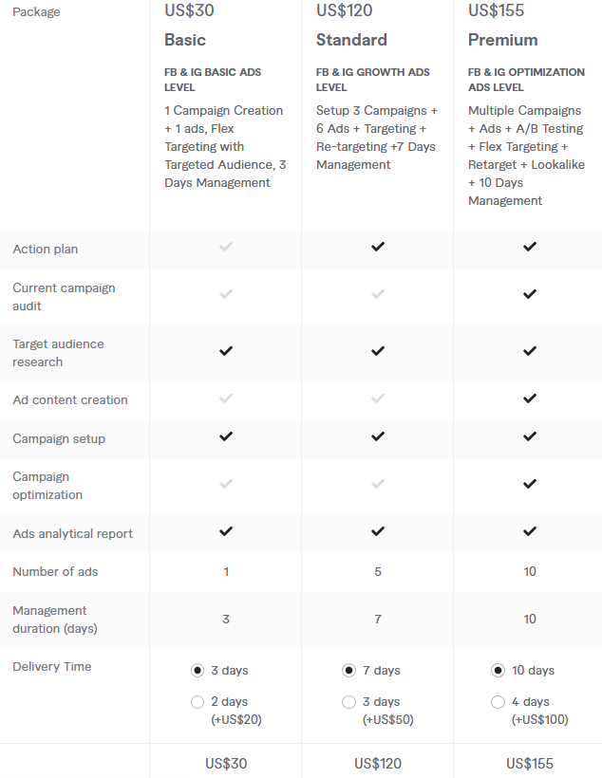
Services – Facebook Ads
Freelance Sessions

Slide 21
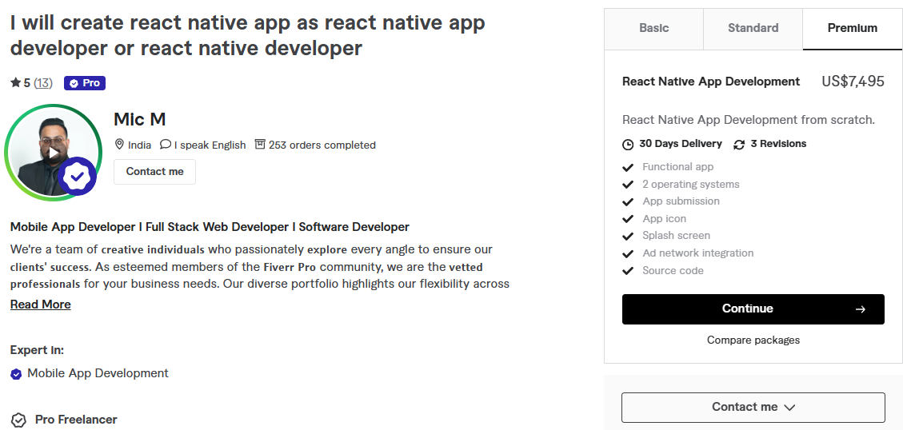
Services – Mobile apps
Freelance Sessions

Slide 22
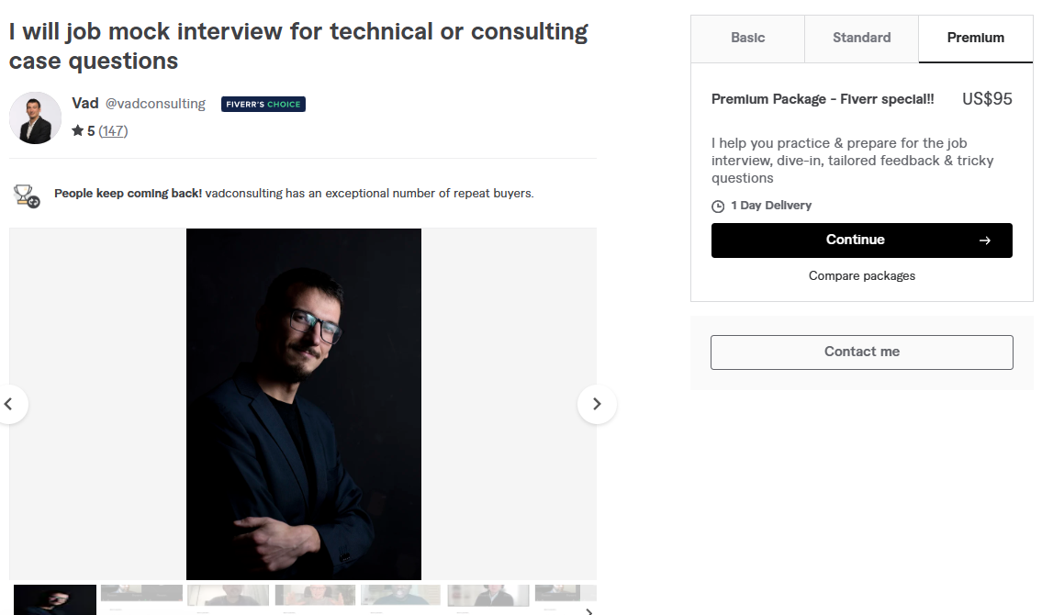
Services – Mock technical interviews
Freelance Sessions

